Slide 1
Romania – Republic of Serbia IPA Cross-border Cooperation Programme
Programming Languages
Lecturer: lect. dr. eng. Razvan BOGDAN
Notes:
Slide 1: Hello everyone and welcome to programming languages course. In this course we will be mainly concerned with understanding some basic concepts about programming languages and we will be referring in particular to Python programming language.

Slide 2
Programming Languages
Lecture 1
Introduction

Slide 3
Reasons to learn Python
Python has simple, conventional syntax
Python has safe semantics
Python scales well
Python is highly interactive
Python is general purpose
Python is free and is in widespread use in industry
Notes:
Slide 3: Reasons to learn Python: There are different reasons why someone might want to learn Python.
“_Python has a simple, conventional syntax. Python statements are very close to
those of pseudocode algorithms, and Python expressions use the conventional
notation found in algebra. Thus, students can spend less time learning
the syntax of a programming language and more time learning to solve
interesting problems.
_ Python has safe semantics. Any expression or statement whose meaning
violates the definition of the language produces an error message.
_ Python scales well. It is very easy for beginners to write simple programs in
Python. Python also includes all of the advanced features of a modern programming
language, such as support for data structures and object-oriented
software development, for use when they become necessary.
_ Python is highly interactive. Expressions and statements can be entered at
an interpreter’s prompts to allow the programmer to try out experimental
code and receive immediate feedback. Longer code segments can then be
composed and saved in script files to be loaded and run as modules or
standalone applications.
_ Python is general purpose. In today’s context, this means that the language
includes resources for contemporary applications, including media computing
and networks.” (source: K. Lambert’s book, Fundamentals of Python From First Programs through Data Structures, pp. xxii)

Slide 4

Python resources
Charles Severance:
Python for Informatics: Exploring Information
Kenneth Alfred Lambert
Fundamentals of Python: From First Programs Through Data Structures
Web resources:
http://learnpythonthehardway.org/book/
https://docs.python.org
Notes:
Slide 4: Python resources: As textbooks for these series we will be using mainly Python for Informatics: Exploring Information of Professor Charles Severance which is distributed under a Creative Commons Attribution License. Another textbook is Fundamentals of Python: From First Programs Through Data Structures of professor Kenneth Alfred Lambert. But also on the web you will find a large spectrum of resources available for learning Python.

Slide 5
Terminology
Machine language – the language of the CPU
Translator – convert the high-level program code into executable code
Interpreter – execute the program
Image source: K. Lambert, Fundamentals of Python From First Programs through Data Structures
Notes:
Slide 5: Terminology: “Python is a high-level language intended to be relatively straightforward for humans to read and write and for computers to read and process. Other high-level languages include: Java, C++, PHP, Ruby, Basic, Perl, JavaScript, and many more.
The actual hardware inside the Central Processing Unit (CPU) does not understand any of these high level languages.
The CPU understands a language we call machine-language. Machine language is very simple and frankly very tiresome to write because it is represented all in
zeros and ones. Since machine language is tied to the computer hardware, machine language is not portable across different types of hardware. Programs written in high-level languages can be moved between different computers by using a different interpreter on the new machine or re-compiling the code to create a machine language
version of the program for the new machine. “ (source Ch. Severance’s book, Python for Informatics, pp. 8 )
“A programmer typically starts by writing high-level language statements in a text editor. The programmer then runs another program called a translator to
convert the high-level program code into executable code. Because it is possible for a programmer to make grammatical mistakes even when writing high-level
code, the translator checks for syntax errors before it completes the translation process. If it detects any of these errors, the translator alerts the programmer via
error messages. The programmer then has to revise the program. If the translation process succeeds without a syntax error, the program can be executed by the
run-time system. The run-time system might execute the program directly on the hardware or run yet another program called an interpreter or virtual
machine to execute the program.” (source K. Lambert’s book, Fundamentals of Python From First Programs through Data Structures, pp. 9)
Basically, “An interpreter reads the source code of the program as written by the programmer, parses the source code, and interprets the instructions on-the-fly. Python is
an interpreter and when we are running Python interactively, we can type a line of Python (a sentence) and Python processes it immediately and is ready for us to
type another line of Python.” (source Ch. Severance’s book, Python for Informatics, pp. 9 )

Slide 6
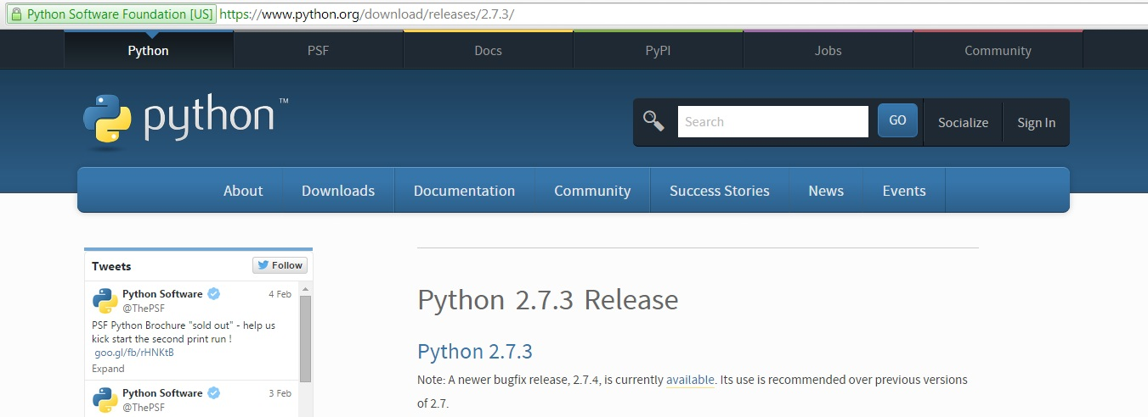
Installing Python (1)
A spectrum of Integrated Development Environments used to develop Python programs (scripts)
Python 2.7.3 Release
You can download it from https://www.python.org/download/releases/2.7.3/
Notes:
Slide 6: Installing Python(1): For the beginning let’s install Python. During these presentations we will be using Python 2.7.3. Even if Python 3 is already available, most of the teaching classes that are presenting Python, refer to Python 2.7.3. However, we will be referring to Python 3.0 from time to time, just to point out some major differences. There is a large spectrum of Integrated Development Environments that are being offered in order to develop Python scripts and projects. In order to keep the things simple, we will be presenting two such ways to develop Python programs. From these two, we will be using Enthought Canopy as the main IDE for the class.

Slide 7
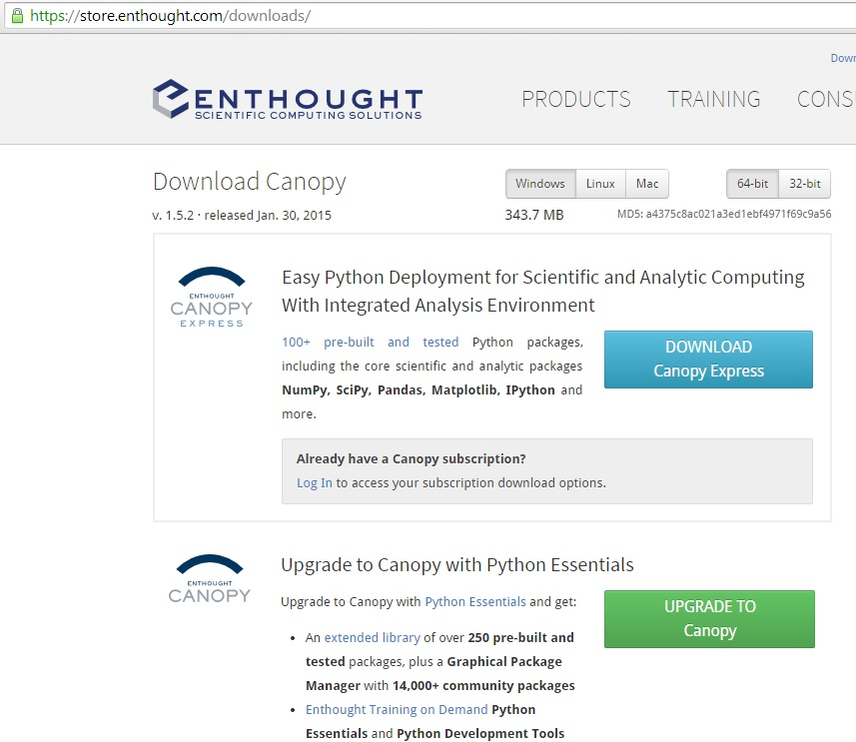
Installing Python (2)
Enthought Canopy
Depending on your system (32-bit or 64-bit OS), you can download it from https://store.enthought.com/downloads/
Follow the on-screen guidance of the Canopy installer
Notes:
Slide 7: Installing Python(2): We will be referring to a Windows installation of Canopy; for other Operating Systems, there is plenty of documentation on Enthought canopy site.
So, first of all download a Windows installer from the Canopy download page. There are two choices to make: 32- or 64-bit, and (subscribers only) Express or Full. On 32-bit Windows, you must use a 32-bit installer. On 64-bit Windows, you can use either 32- or 64-bit, though the provider recommends the 64-bit installer unless you know you need the 32-bit version.

Slide 8
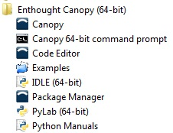
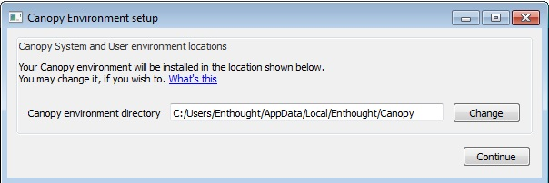
Installing Python (3)
Enthought Canopy
When Canopy is launched for the first time, it will automatically configure your Python environment
Notes:
Slide 8: Installing Python(3): Once the installation process is complete, the last step is to set up your Python environment. Launching the GUI by selecting ‘Canopy’ from the Windows Start Menu will start Canopy and the UI will guide you through the process.

Slide 9
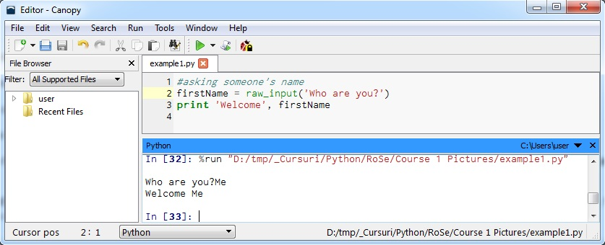
Enthought Canopy (1)
1. File browser pane
2. Code editor
3. Python pane
4. Editor status bar
2
1
3
4
Notes:
Slide 9: Enthought Canopy (1): Now, let’s have a look at the key pieces of the Code Editor. First of all, there is the File browser pane which shows one or more directories and any recently opened files. If we double-click a file, then it will be opened it in the Code Editor.
Then, there is the Code editor which is a general purpose text-editor, but in addition to that there are implemented specific features for editing Python code.
The Python pane integrates an Interactive Python prompt (usually known as IPython prompt) that allows the programmer to test the code; and finally Editor status bar which shows different information about the file currently displayed in the code editor. Such information includes line and column (2 and 1, respectively, in the image from the slide), file type, and file path and name.

Slide 10
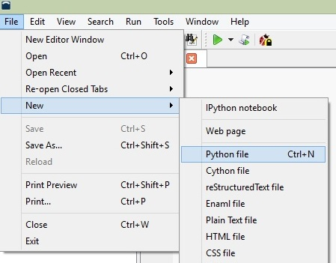
Let’s build an example
Notes:
Slide 10: Let’s build an example: Now, let’s build an example. We would like to print a message to the user, let’s say asking him Who are you? Then we will read the sequence of characters introduced from the keyboard (supposedly someone’s name) and greet that person. For this, we will create a new Python file, also called a script, name it example1.py and in the text editor we will write the Python code. After that we can run the current file, by selecting the green-triangle button. The result of the script will be available in the Python pane.

Slide 11
Homework
Download Canopy and install it on your own systems.
Try to implement the examples in Python pane
Notes:
Slide 11: Homework: As homework, please download Canopy and install it on your own systems and then try to implement the example we have presented in this course. The same example try to put it after that in Python pane and watch its execution since most of our code will be written in Python pane.

